Slide 1

Relational Algebra
Chapter # 07

Slide 2
Relational Algebra & Calculus
Relational algebra and relational calculus are formal languages associated with the relational model.
Informally, relational algebra is a (high-level) procedural language and relational calculus a non-procedural language.
  Relational Algebra: More operational (procedural), very useful for representing execution plans.
  Relational Calculus: Lets users describe what they want, rather than how to compute it: Non-operational, declarative.
However, formally both are equivalent to one another.

Slide 3
Relational Algebra
The basic set of operations for the relational model is the relational algebra.
  enable the specification of basic retrievals
Relational algebra operations work on one or more relations to define another relation without changing the original relations.
Both operands and results are relations, so output from one operation can become input to another operation.
Allows expressions to be nested, just as in arithmetic.

Slide 4
Relational Algebra
Five basic operations in relational algebra: Selection, Projection, Cartesian product, Union, and Set Difference.
These perform most of the data retrieval operations needed.
Also have Join, Intersection, and Division operations, which can be expressed in terms of 5 basic operations.

Slide 5
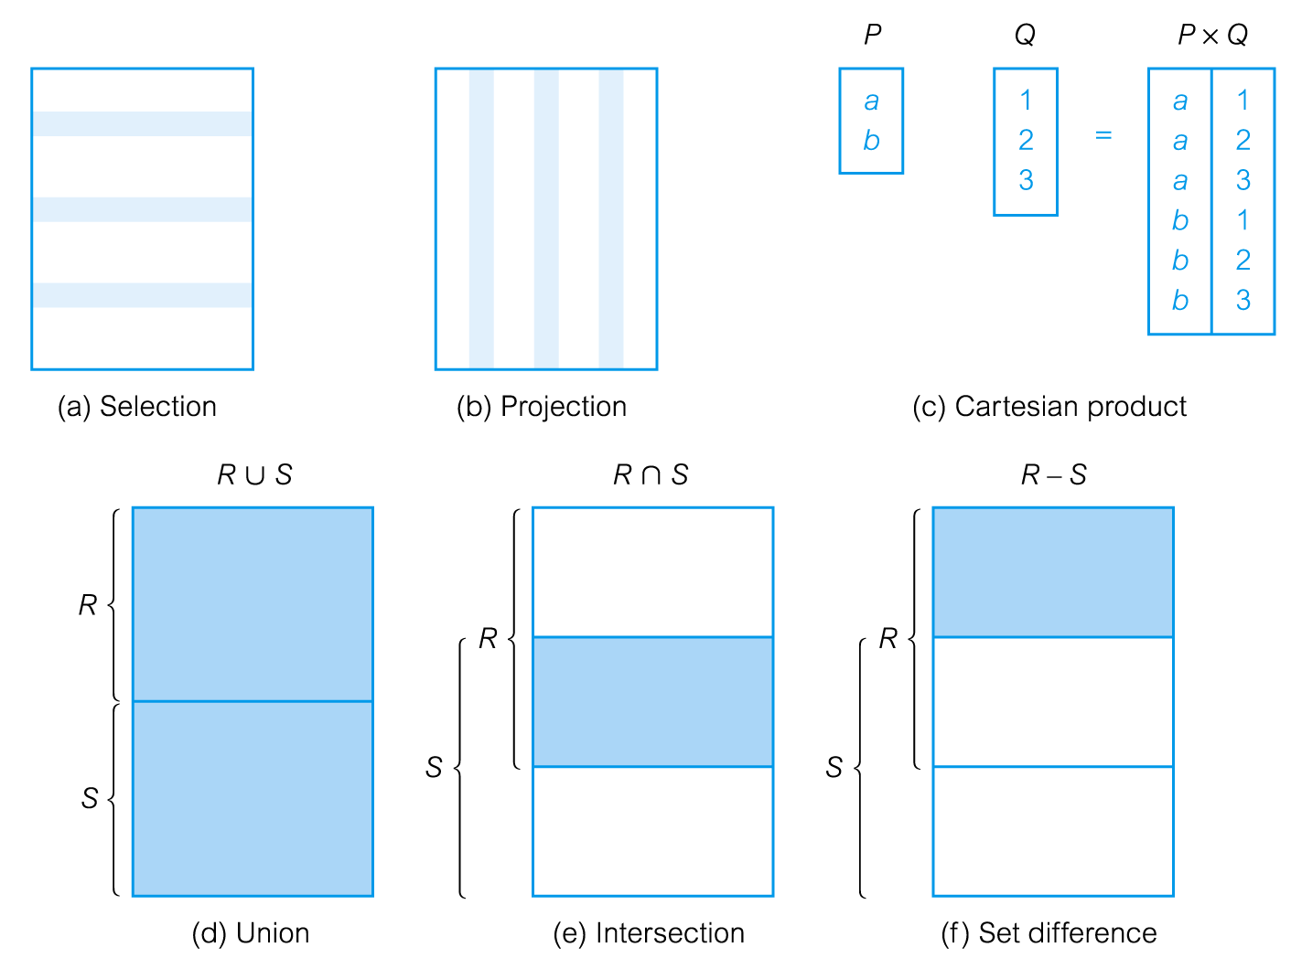
Relational Algebra Operations

Slide 6
Unary Relational Operations
SELECT Operation: used to select a subset of the tuples from a relation that satisfy a selection condition. It is a filter that keeps only those tuples that satisfy a qualifying condition.
Examples:
σDNO = 4 (EMPLOYEE)
σSALARY > 30,000 (EMPLOYEE)
  denoted by _{σ <selection condition>}(R) where the symbol σ (sigma) is used to denote the select operator, and the selection condition is a Boolean expression specified on the attributes of relation R

Slide 7
SELECT Operation Properties
The SELECT operation σ _{<selection condition>}(R) produces a relation S that has the same schema as R
The SELECT operation σ is commutative; i.e.,
  σ _{<condition1>}(σ _{< condition2>} ( R)) = σ _{<condition2>} (σ _{< condition1>} ( R))
A cascaded SELECT operation may be applied in any order; i.e.,
  σ _{<condition1>}(σ _{< condition2>} (σ _{<condition3>} ( R))
  = σ _{<condition2>} (σ _{< condition3>} (σ _{< condition1>} ( R)))
A cascaded SELECT operation may be replaced by a single selection with a conjunction of all the conditions; i.e.,
  σ _{<condition1>}(σ _{< condition2>} (σ _{<condition3>} ( R))
  = σ <condition1> AND < condition2> AND < condition3> ( R)))

Slide 8
Selection Condition
Operators: <, ≤, ≥, >, =, ≠
Simple selection condition:
  <attribute> operator <constant>
  <attribute> operator <attribute>
  <condition> AND <condition>
  <condition> OR <condition>
  NOT <condition>

Slide 9
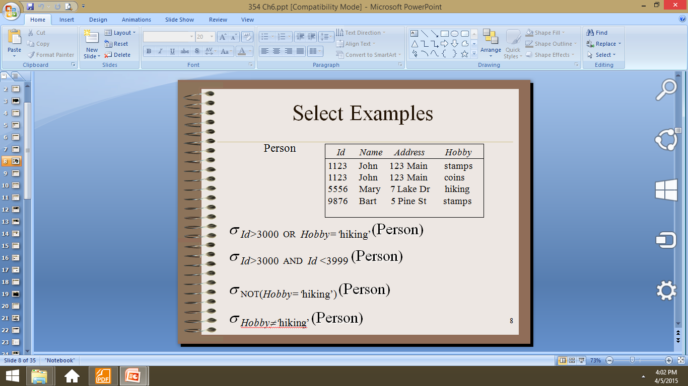
Selection Condition
σ _{Id>3000 OR Hobby=‘hiking’} (Person)
σ _{Id>3000 AND Id <3999} (Person)
σ _{NOT(Hobby=‘hiking’)} (Person)
σ _{Hobby≠‘hiking’} (Person)

Slide 10
Unary Relational Operations
PROJECT Operation: selects certain columns from the table and discards the others.
Example:
π_{LNAME, FNAME,SALARY}(EMPLOYEE)
The general form of the project operation is:
π<attribute list>(R)
where π is the symbol used to represent the project operation and <attribute list> is the desired list of attributes.
PROJECT removes duplicate tuples, so the result is a set of tuples and hence a valid relation.

Slide 11
PROJECT Operation Properties
  The number of tuples in the result of π _{<list>} (R) is always less or equal to the number of tuples in R.
  If attribute list includes a key of R, then the number of tuples is equal to the number of tuples in R.

Slide 12
SELECT and PROJECT Operations
(a) σ(DNO=4 AND SALARY>25000) OR (DNO=5 AND SALARY>30000)(EMPLOYEE)
(b) π_{LNAME, FNAME, SALARY}(EMPLOYEE)

Slide 13
RENAME operation
RENAME operation
Rename attributes in intermediate results
ρS(B1,B2, ...,Bn)(R)
ρS(R)
ρ(B1,B2, ...,Bn)(R)
where the symbol ρ(rho) is used to denote the RENAME operator,
S is the new relation name, and B1, B2, ..., Bn are the new attribute names.

Slide 14
RENAME operation
The first expression renames both the relation and its attributes
ρS(B1,B2, ...,Bn)(R)
The second renames the relation only
ρS(R)
The third renames the attributes only.
ρ(B1,B2, ...,Bn)(R)
If the attributes of Rare (A1,A2, ...,An) in that order, then each Ai is renamed as Bi.

Slide 15
Relational Algebra Operations from Set Theory
The UNION, INTERSECTION, and MINUS Operations
The CARTESIAN PRODUCT (or CROSS PRODUCT) Operation

Slide 16
Set Operators
A relation is a set of tuples, so set operations apply:
  ∩, ∪, − (set difference)
Result of combining two relations with a set operator is a relation => all elements are tuples with the same structure

Slide 17
UNION Operation
Denoted by R ∪ S
Result is a relation that includes all tuples that are either in R or in S or in both. Duplicate tuples are eliminated.
Example: Retrieve the SSNs of all employees who either work in department 5 or directly supervise an employee who works in department 5:
DEP5_EMPS ← σ_{DNO=5} (EMPLOYEE)
RESULT1 ← π _{SSN}(DEP5_EMPS)
RESULT2(SSN) ← π _{SUPERSSN}(DEP5_EMPS)
RESULT ← RESULT1 ∪ RESULT2
The union operation produces the tuples that are in either RESULT1 or RESULT2 or both. The two operands must be “type compatible”.

Slide 18
UNION Operation
Type (Union) Compatibility
The operand relations R₁(A₁, A₂, ..., A_{n}) and R₂(B₁, B₂, ..., B_{n}) must have the same number of attributes, and the domains of corresponding attributes must be compatible, i.e.
  dom(A_{i}) = dom(B_{i}) for i=1, 2, ..., n.

Slide 19
Intersection Operation
Denoted by R ∩ S
The intersection operation also has the requirement that both the relations should be union compatible, which means they are of same degree and same domains.
If R and S are two relations and we take intersection of these two relations then the resulting relation would be the set of tuples, which are in both R and S. Just like union intersection is also commutative.
R ∩ S = S ∩R

Slide 20
Example
Tables
Person (SSN, Name, Address, Hobby)
Professor (Id, Name, Office, Phone)
are not union compatible.
But
π _{Name} (Person) and π _{Name} (Professor)
are union compatible

Slide 21
Set Difference
Set Difference (or MINUS) Operation
The result of this operation, denoted by R - S, is a relation that includes all tuples that are in R but not in S. The two operands must be "type compatible”.

Slide 22
Relational Algebra Operations From Set Theory
Union and intersection are commutative operations:
R ∪ S = S ∪ R, and R ∩ S = S ∩ R
Both union and intersection can be treated as n-ary operations applicable to any number of relations as both are associative operations; that is
R ∪ (S ∪ T) = (R ∪ S) ∪ T, and
(R ∩ S) ∩ T = R ∩ (S ∩ T)
The minus operation is not commutative; that is, in general
R - S ≠ S – R

Slide 23
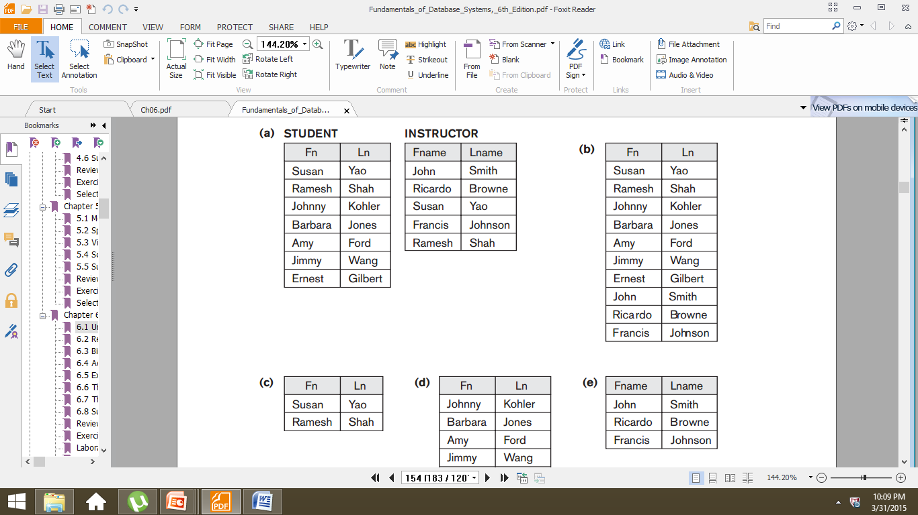
Relational Algebra Operations from Set Theory

Slide 24
Cartesian (Cross) Product
If R and S are two relations, R × S is the set of all concatenated tuples <x,y>, where x is a tuple in R and y is a tuple in S
  R and S need not be union compatible
R × S is expensive to compute
A B C D A B C D
x1 x2 y1 y2 x1 x2 y1 y2
x3 x4 y3 y4 x1 x2 y3 y4
x3 x4 y1 y2
R S x3 x4 y3 y4
R× S

Slide 25
Binary Relational Operations: JOIN and DIVISION
The JOIN Operation
The EQUIJOIN and NATURAL JOIN variations of JOIN
The DIVISION Operation

Slide 26
JOIN
Cartesian product followed by select is commonly used to identify and select related tuples from two relations => called JOIN. It is denoted by a
  This operation is important for any relational database with more than a single relation, because it allows us to process relationships among relations.
  The general form of a join operation on two relations R(A₁, A₂, . . ., A_{n}) and S(B₁, B₂, . . ., B_{m}) is:
R _{<join condition>}S
where R and S can be any relations that result from general relational algebra expressions

Slide 27
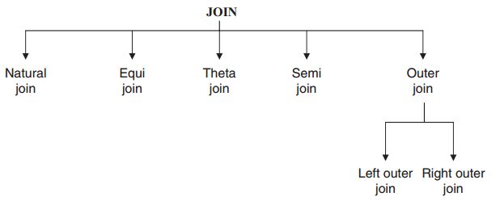
Types of JOIN

Slide 28
Natural Join
The natural join performs an equi join of the two relations R and S over all common attribute
a natural join will remove duplicate attribute
In most systems a natural join will require that the attributes have the same name to identity the attributes to be used in the join.
This may require a renaming mechanism.
Denoted by *

Slide 29
Natural Join
Input: Two relations (tables) R and S
Notation: R S
Purpose: Relate rows from second table and
– Enforce equality on all column attributes
– Eliminate one copy of common attribute

Slide 30
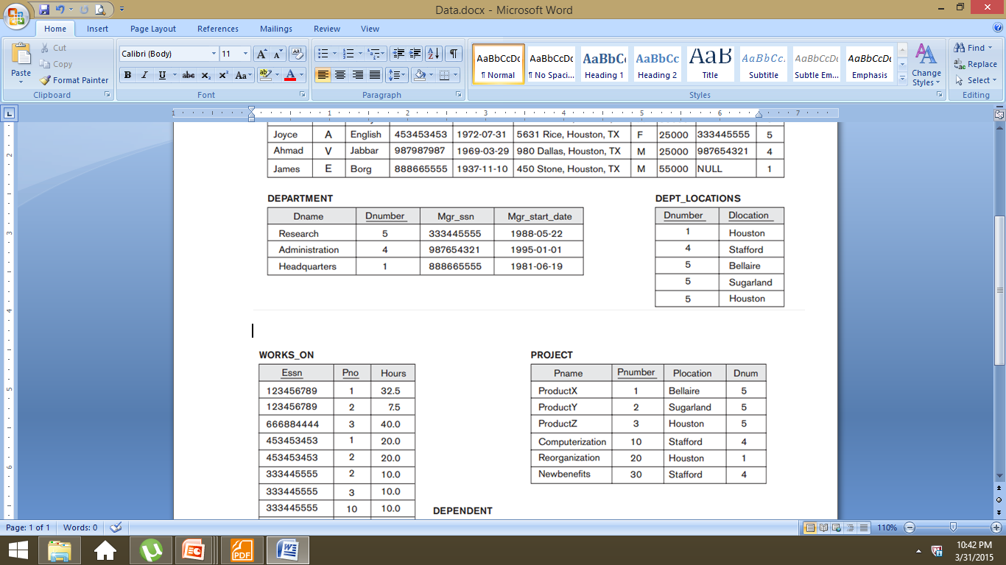
NATURAL JOIN

Slide 31
NATURAL JOIN
In the following example, first we rename the Dnumber attribute
Of DEPARTMENT to Dnum—so that it has the same name as the Dnum attribute in PROJECT—and then we apply NATURAL JOIN:
PROJ_DEPT ← PROJECT *ρ(Dname, Dnum, Mgr_ssn,Mgr_start_date)(DEPARTMENT)

Slide 32
EQUIJOIN
Only = comparison operator used
Always have one or more pairs of attributes that have identical values in every tuple
In the result of an EQUIJOIN we always have one or more pairs of attributes that have identical values in every tuple.

Slide 33
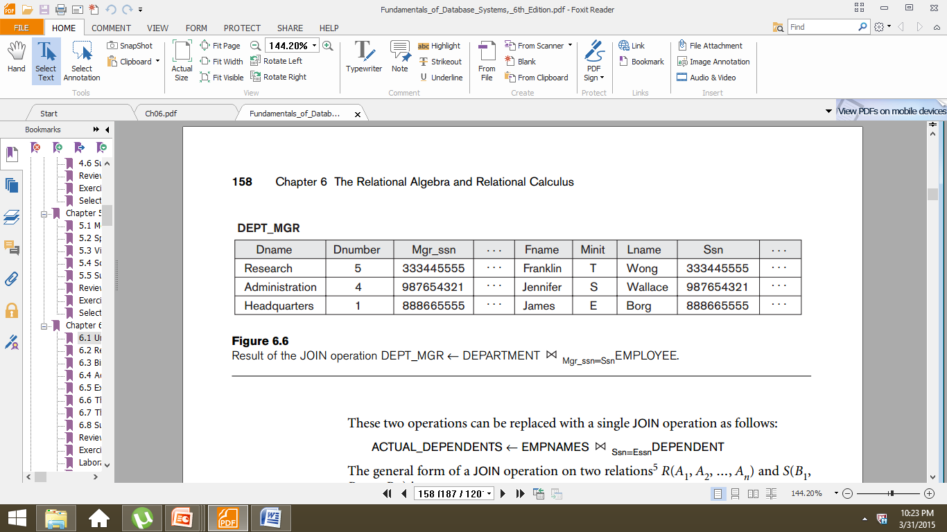
EQUIJOIN

Slide 34
THETAJOIN
A conditional join in which we impose condition other than equality condition.
If equality condition is imposed then theta join become equi join. The symbol
Θ stands for the comparison operator which could be
>, <, >=,<=.
Expression of Theta Join σθ(R×S)

Slide 35
OUTER JOINs
Tuples without a matching(or related) tuple are eliminated from the JOIN result.
Tuples with NULL values in the join attributes are also eliminated.
This type of join, where tuples with no match are eliminated, is known as an inner join
Outer joins, can be used when we want to keep all the tuples in R, all those in S, or all those in both relations

Slide 36
OUTER JOINs
Types
LEFT OUTER JOIN
RIGHT OUTER JOIN
FULL OUTER JOIN

Slide 37
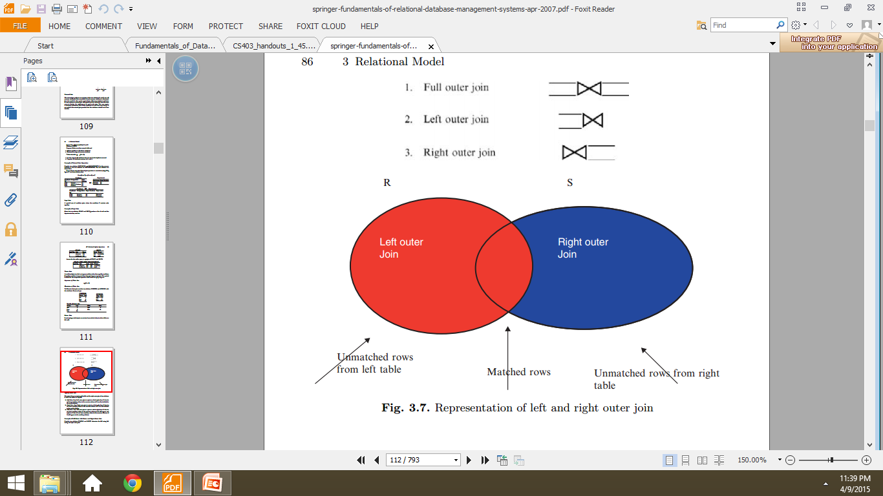

OUTER JOINs

Slide 38
Left & Right outer join
The left outer join operation keeps every tuple in the first or left relation R in R S; if no matching tuple is found in S, then the attributes of S in the join result are “padded” with null values.
A similar operation, right outer join, keeps every tuple in the second or right relation S in the result of R S.

Slide 39
Full Outer Join
A third operation, full outer join, denoted by keeps all tuples in both the left and the right relations when no matching tuples are found, padding them with null values as needed.

Slide 40
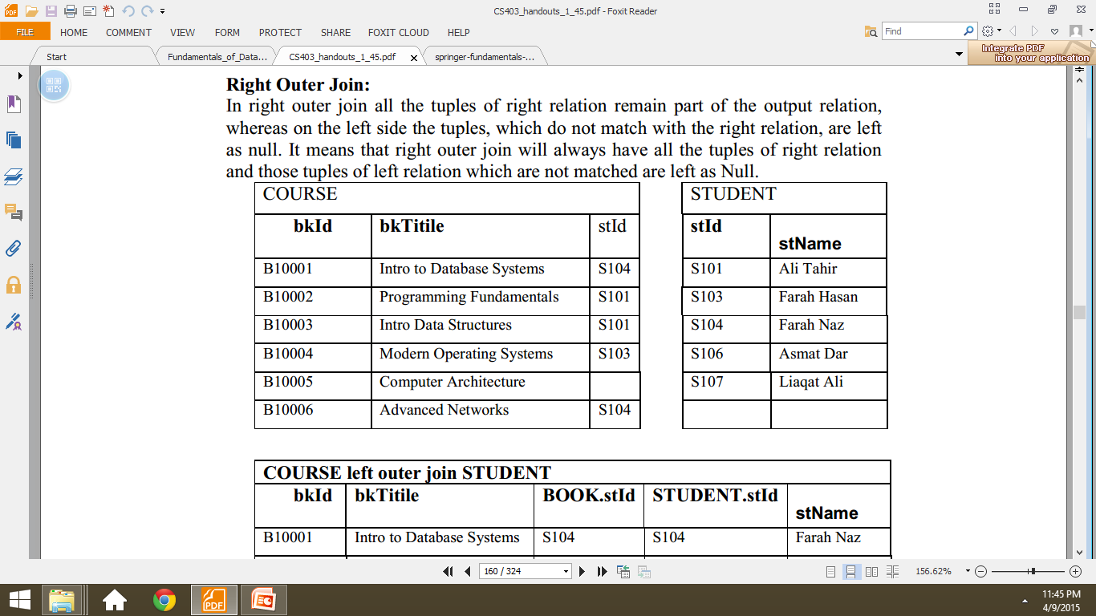
Example

Slide 41
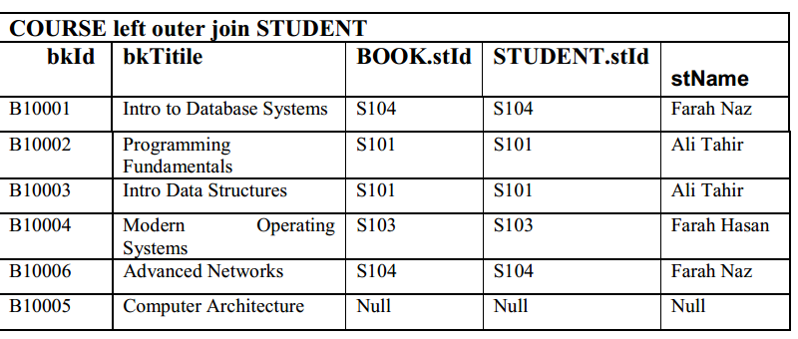
LEFT OUTER JOIN

Slide 42
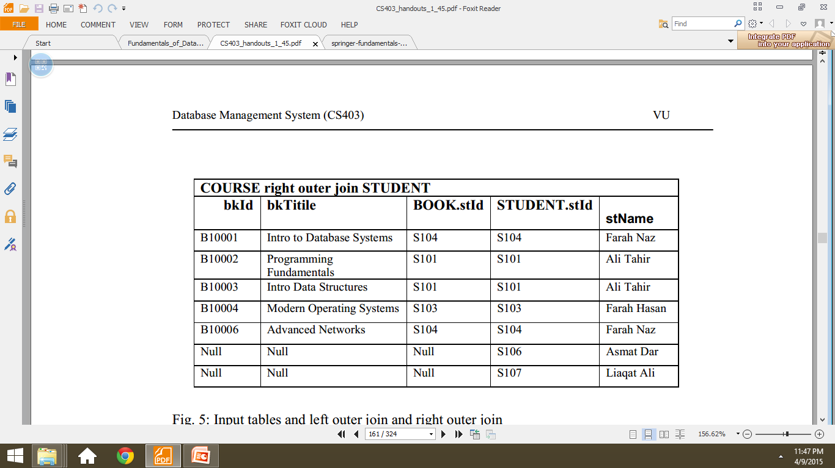
RIGHT OUTER JOIN

Slide 43
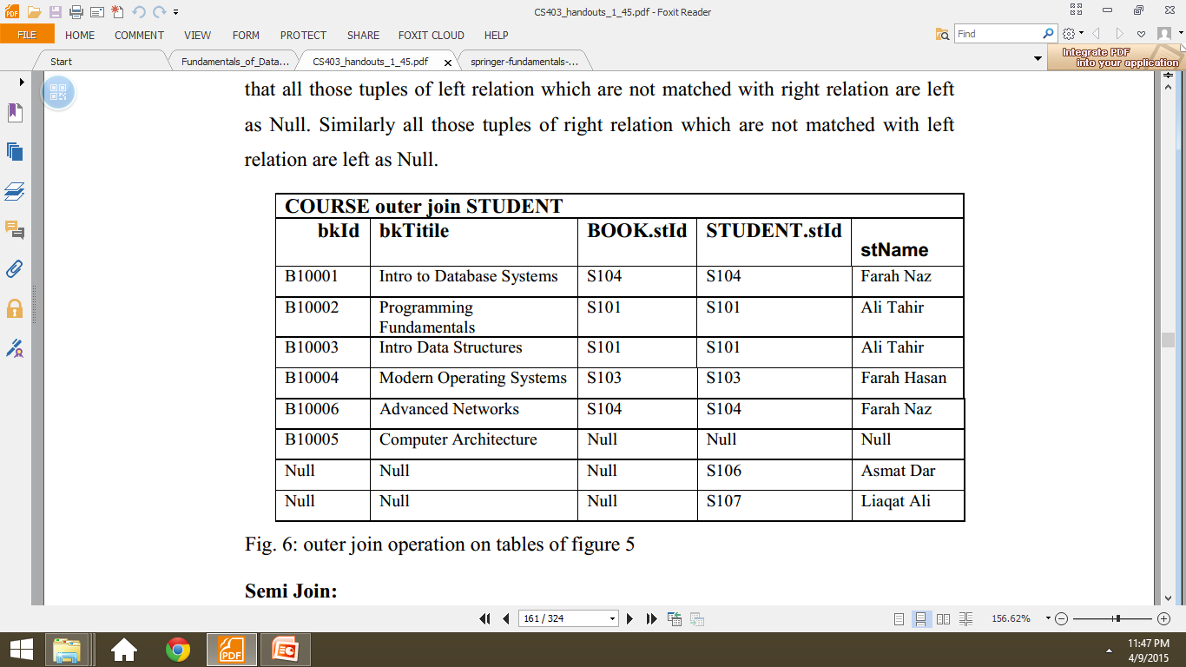
FULL OUTER JOIN

Slide 44
Semi Join
In semi join, first we take the natural join of two relations then we project the attributes of first table only. So after join and matching the common attribute of both relations only attributes of first relation are projected.

Slide 45
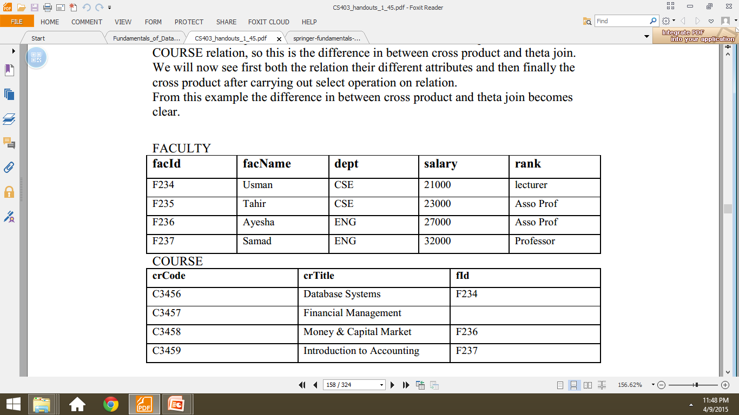
Example 2

Slide 46
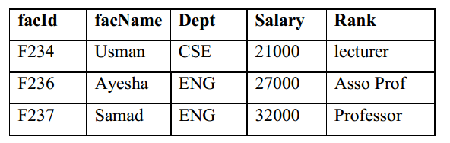
Semi Join

Slide 47
Division
• Suppose A has two groups of fields <x,y>
• y fields are same fields in terms of domain as B
• A/B = <x> such as for every y value in a tuple of B there is <x,y> in A

Slide 48
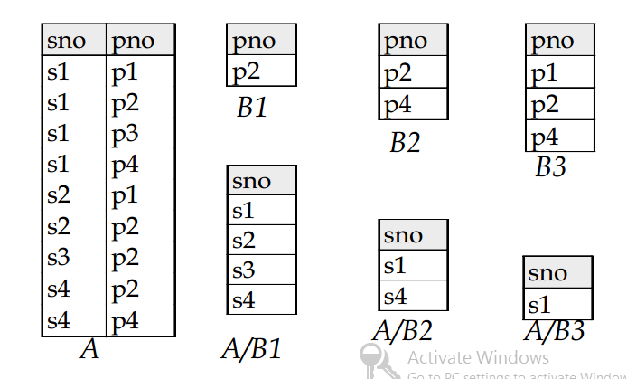
Division

Slide 49
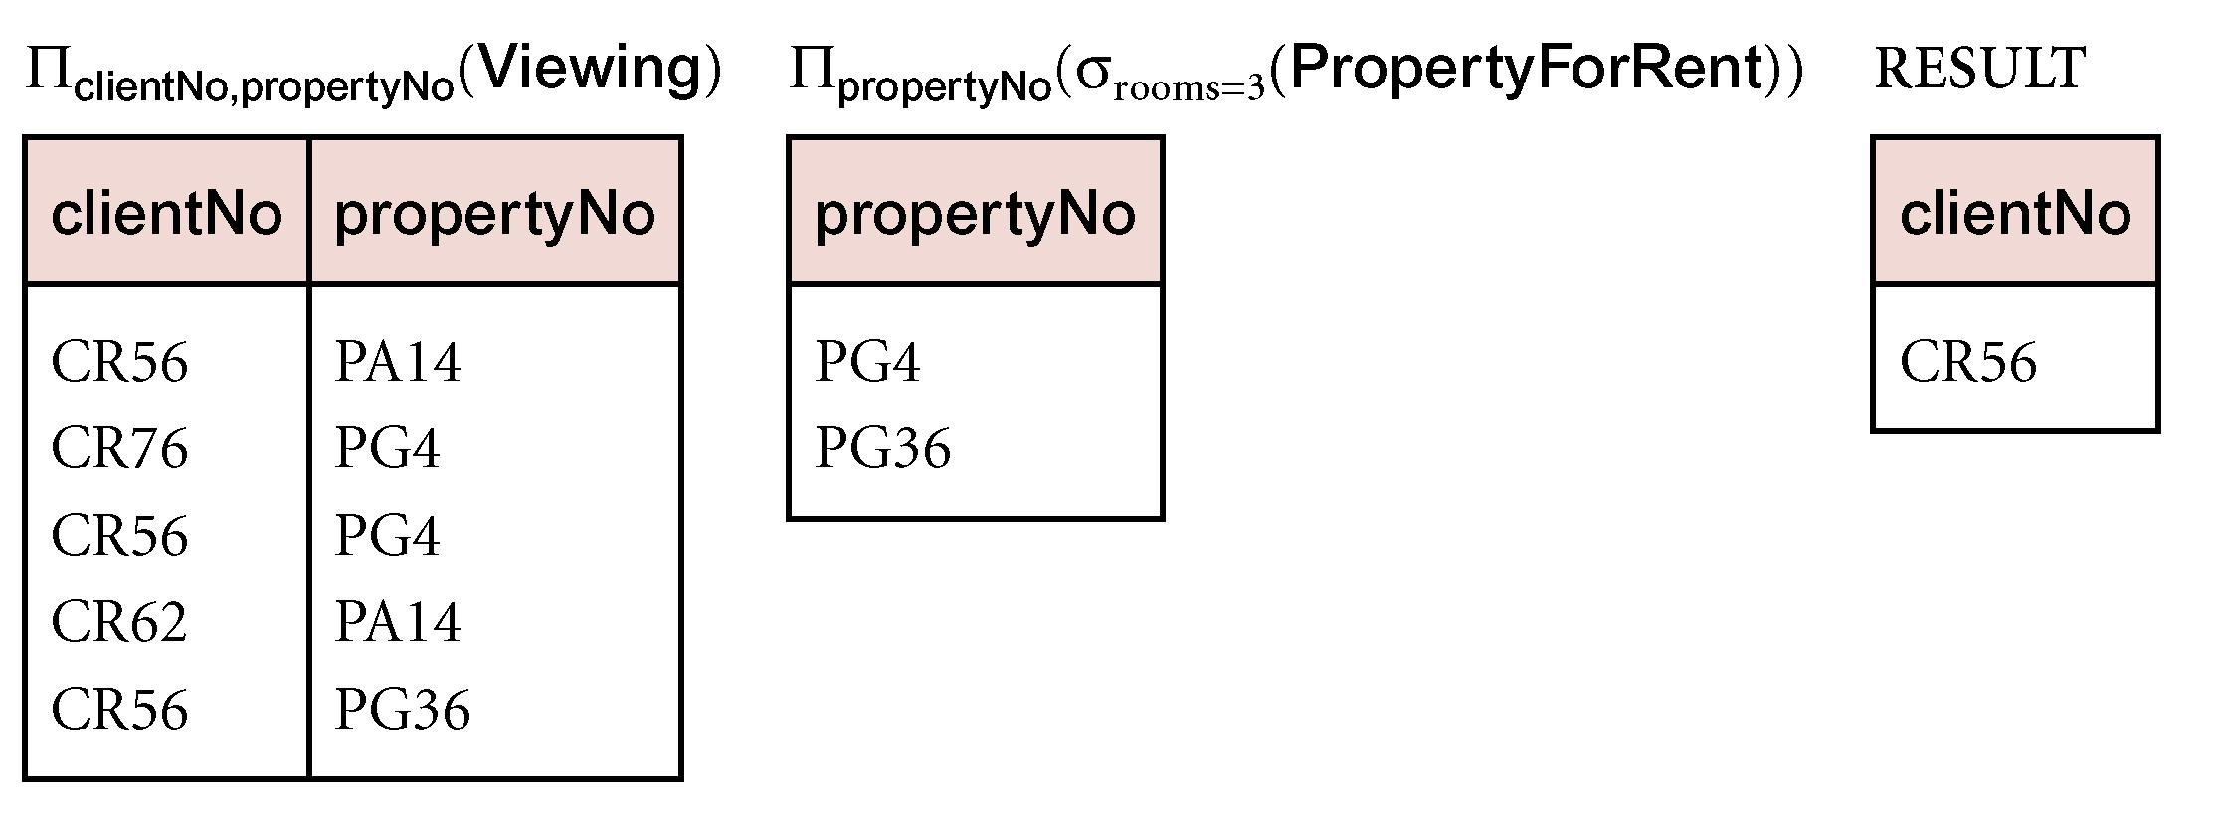
Division
Identify all clients who have viewed all properties with three rooms.
  (Π_{clientNo, propertyNo}(Viewing)) ÷
  (Π_{propertyNo}(σ_{rooms = 3} (PropertyForRent)))

Slide 50
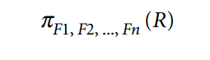
Additional Relational Operations
Generalized Projection
The generalized projection operation extends the projection operation by allowing functions of attributes to be included in the projection list. The generalized form can be expressed as

Slide 51
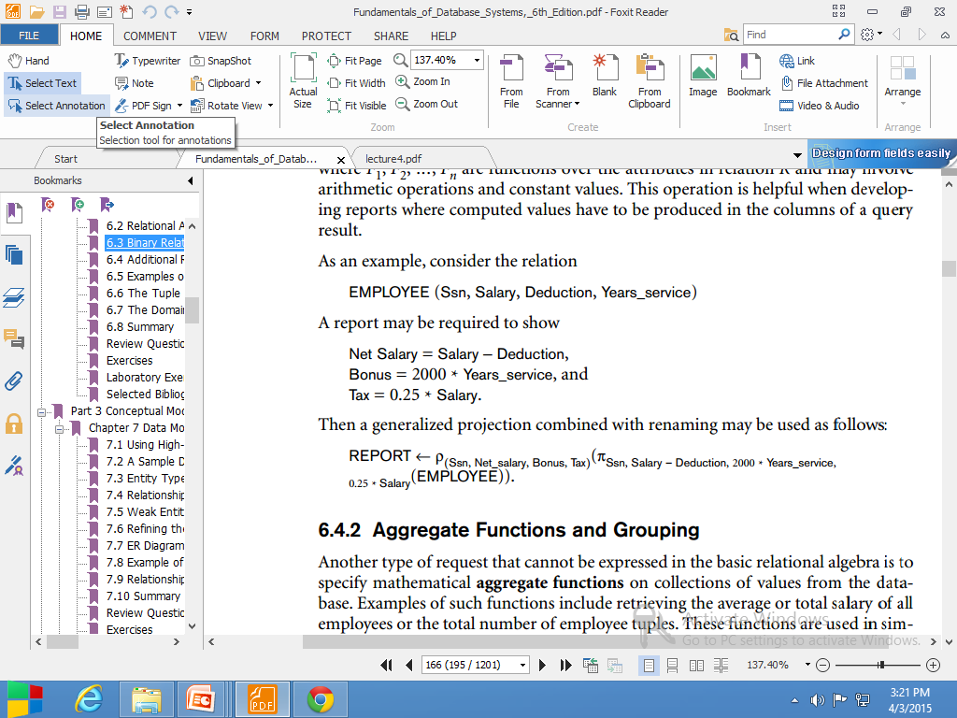
Generalized Projection

Slide 52
Aggregate functions and grouping
Common functions applied to collections of numeric values
Include SUM, AVERAGE, MAXIMUM, and MINIMUM

Slide 53
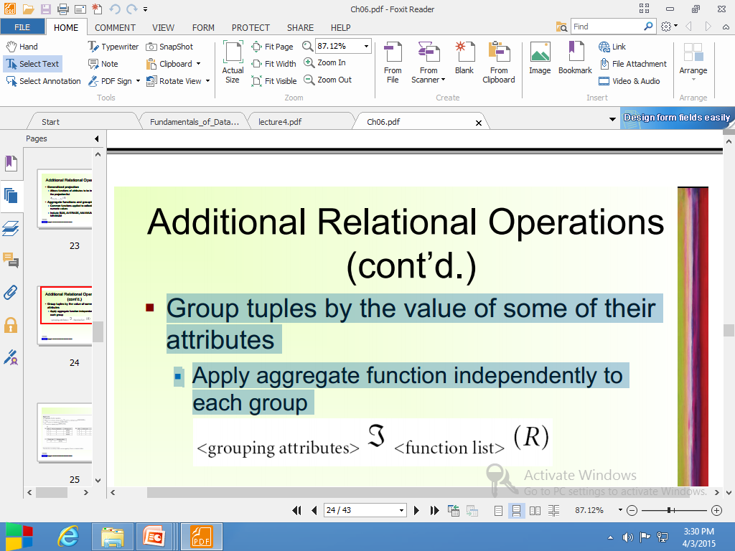
Aggregate functions
Group tuples by the value of some of their attributes
Apply aggregate function independently to each group

Slide 54
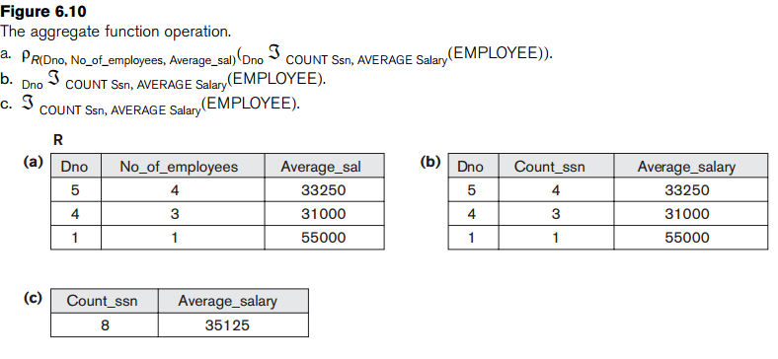
Aggregate functions

